Slide 1
CENG-232 Logic Design
Sequential Circuit Design
Acknowledgment: Most of the following slides are adapted from Prof. Kale's slides at UIUC, USA.

Slide 2
Sequential Circuit Design
Sequential circuit design: Given a description (or problem), produce a working circuit for it.
We first make a state table or diagram to express the computation.
Then we can turn that table or diagram into a sequential circuit.

Slide 3
Analysis vs Design
Remember the analysis steps:
Circuit diagram is given
Output and next state equations
State table
(optional) description of what the circuit does.
Design is going through the above steps in the reverse order.
A design example in the next slides.

Slide 4
Let’s design a Sequence Recognizer
A sequence recognizer is a special kind of sequential circuit that looks for a special bit pattern in some input.
The recognizer circuit has only one input, X.
One bit of input is supplied on every clock cycle. For example, it would take 20 cycles to scan a 20-bit input.
This is an easy way to permit arbitrarily long input sequences.
There is one output, Z, which is 1 when the desired pattern is found.
Our example will detect the bit pattern “1001”:
Input: 1 1 1 0 0 1 1 0 1 0 0 1 0 0 1 1 0 …
Output: 0 0 0 0 0 1 0 0 0 0 0 1 0 0 1 0 0 …

Slide 5
Sequence Recognizer (Cont’d.)
Inputs: 1 1 1 0 0 1 1 0 1 0 0 1 0 0 1 1 0 …
Outputs: 0 0 0 0 0 1 0 0 0 0 0 1 0 0 1 0 0 …
This requires a sequential circuit because the circuit has to “remember” the inputs from previous clock cycles, in order to determine whether or not a match was found.
Here, one input and one output bit appear every clock cycle.
Note that overlapping bit patterns are also detected (2nd and 3rd instances).

Slide 6
Step 1: State diagram (and table)
What state do we need for the sequence recognizer?
We have to “remember” inputs from previous clock cycles.
For example, if the previous three inputs were 100 and the current input is 1, then the output should be 1.
In general, we will have to remember occurrences of parts of the desired pattern - in this case, 1, 10, and 100.
1/0
0/0
0/0
A
B
C
D

Slide 7
Overlapping pattern occurrences
What happens if we’re in state D (the last three inputs were 100), and the current input is 1?
The output should be a 1, because we’ve found the desired pattern.
But this last 1 could also be the start of another occurrence of the pattern! For example, 1001001 contains two occurrences of 1001.
To detect overlapping occurrences of the pattern, the next state should be B.
1/0
0/0
0/0
A
B
C
D
1/1

Slide 8
Filling in the other arrows
Remember that we need two outgoing arrows for each node, to account for the possibilities of X=0 and X=1.
The remaining arrows are shown in blue. They also allow for the correct detection of overlapping occurrences of 1001.
0/0
1/0
1/0
0/0
0/0
A
B
C
D
1/0
0/0
1/1

Slide 9
Finally, making the state table (Step 1 completed)
0/0
1/0
1/0
0/0
0/0
A
B
C
D
1/0
0/0
1/1
Remember how the state diagram arrows correspond to rows of the state table:
present state
input/output
next state

Slide 10
Sequential Circuit Design Procedure
Step 1:
Make a state table based on the problem statement. The table should show the present states, inputs, next states and outputs. (It may be easier to find a state diagram first, and then convert that to a table.)
Step 2:
Assign binary codes to the states in the state table (if you haven’t already). If you have n states, your binary codes will have at least ⎡log2 n⎤ digits, and your circuit will have at least ⎡log2 n⎤ flip-flops.

Slide 11
Sequential circuit design procedure
Step 3:
For each flip-flop and each row of your state table, find the flip-flop input values that are needed to generate the next state from the present state. You can use flip-flop excitation tables here.
Step 4:
Find simplified equations for the flip-flop inputs and the outputs.
Step 5:
Build the circuit!

Slide 12
Step 2: Assigning binary codes
We have four states ABCD, so we need at least two flip-flops Q1Q0.
The easiest thing to do is represent state A with Q1Q0 = 00, B with 01, C with 10, and D with 11 (intuitive).
The state assignment can have a big impact on circuit complexity, but we won’t worry about that too much in this class.

Slide 13
Step 3: Finding flip-flop inputs
Next we have to figure out how to actually make the flip-flops change from their present state into the desired next state.
This depends on what kind of flip-flops you use!
We’ll use two JKs. For each flip-flip Qi, look at its present and next states, and determine what the inputs Ji and Ki should be in order to make that state change.

Slide 14
Finding JK flip-flop input values
For JK flip-flops, this is a little tricky. Recall the characteristic table:
If the present state of a JK flip-flop is 0 and we want the next state to be 1, then we have two choices for the JK inputs:
We can use JK=10, to explicitly set the flip-flop’s next state to 1.
We can also use JK=11, to complement the current state 0.
So to change from 0 to 1, we must set J=1, but K could be either 0 or 1.
Similarly, the other possible state transitions can all be done in two different ways as well.

Slide 15
JK excitation table
An excitation table shows what flip-flop inputs are required in order to make a desired state change.
This is the same information that’s given in the characteristic table, but presented “backwards.”

Slide 16
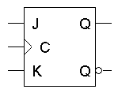
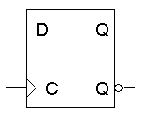
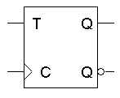
Excitation Tables for all flip-flops

Slide 17
Back to the Example
We can now use the JK excitation table on the right to find the correct values for each flip-flop’s inputs, based on its present and next states.

Slide 18
Step 4: Find FF in/out equations
Now you can make K-maps and find equations for each of the four flip-flop inputs, as well as for the output Z.
These equations are in terms of the present state and the inputs.
The advantage of using JK flip-flops is that there are many don’t care conditions, which can result in simpler equations.
J1 = X’ Q0
K1 = X + Q0
J0 = X + Q1
K0 = X’
Z = Q1Q0X

Slide 19
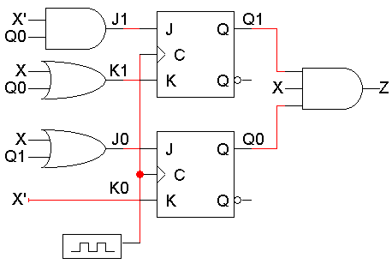
Step 5: Build the Circuit
Lastly, we use these simplified equations to build the completed circuit.
J₁ = X’ Q₀
K₁ = X + Q₀
J₀ = X + Q₁
K₀ = X’
Z = Q₁Q₀X

